Slide 1

Introduction to

Slide 2
Let us start

Slide 3
Agenda
Variables
Conditional
statements
Arithmetic operators
Boolean logic
String
Formatting
Printing
Exercises
Loops

Slide 4
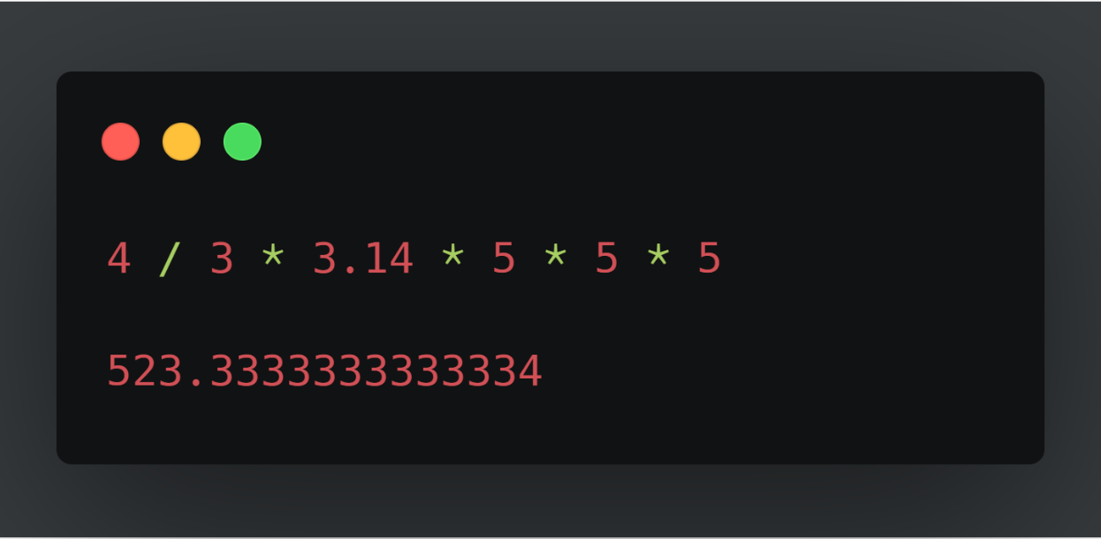
Python as a calculator

Slide 5
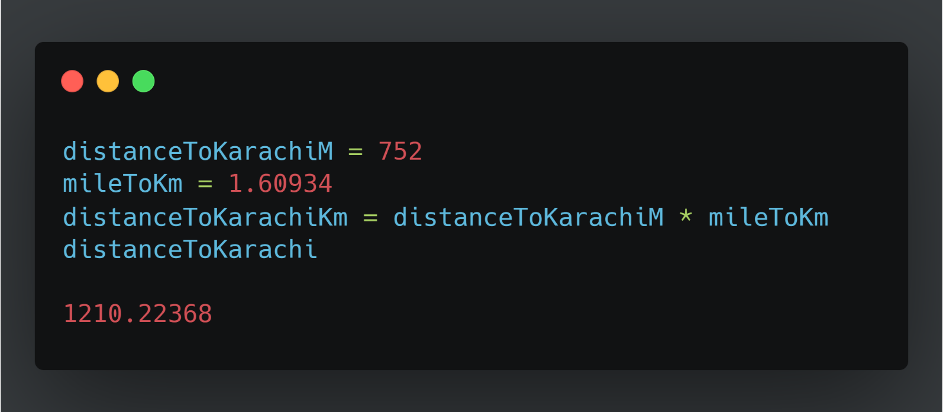
Variables
Great calculator but how can we make it store values?
Do this by defining variables
Can later be called by the variable name
Variable names are case sensitive and unique

Slide 6
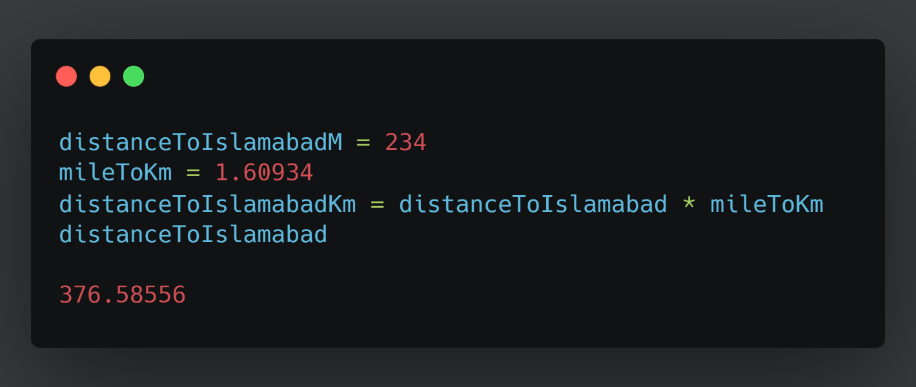
We can now reuse the variable mileToKm in the next lines without having to define it again!

Slide 7
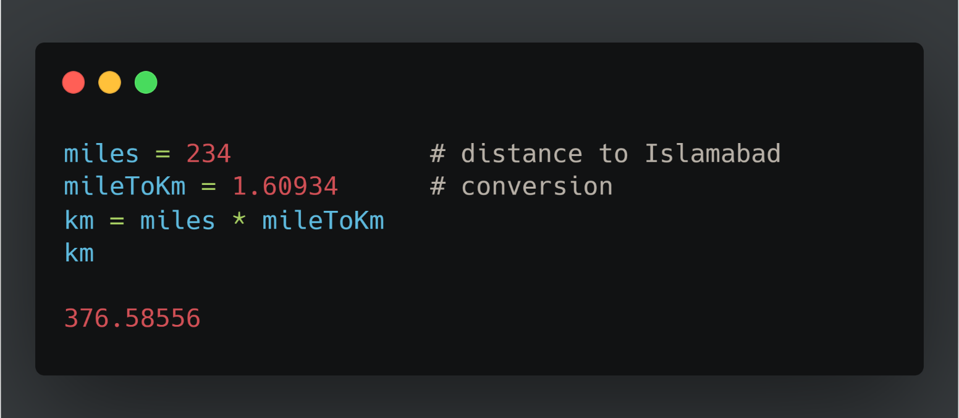
Commenting
Useful when your code needs further explanation. Either for your future self and anybody else.
Useful when you want to remove the code from execution but not permanently
Comments in Python are done with #

Slide 8
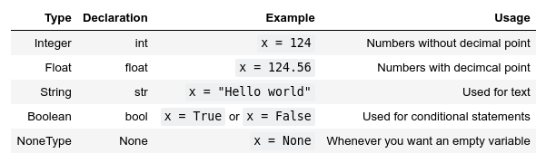
Types
Variables actually have a type, which defines the way it is stored.
The basic types are:

Slide 9

Why should we care?

Slide 10
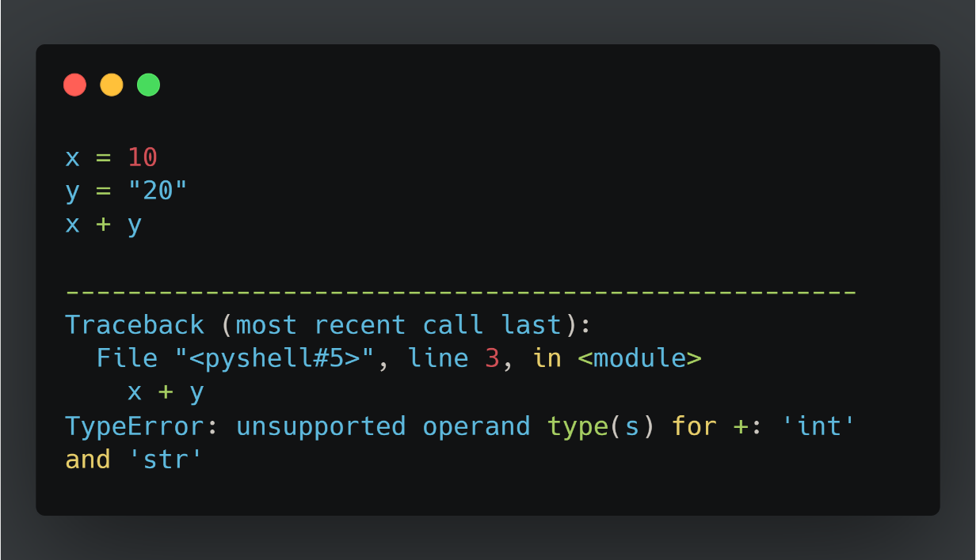
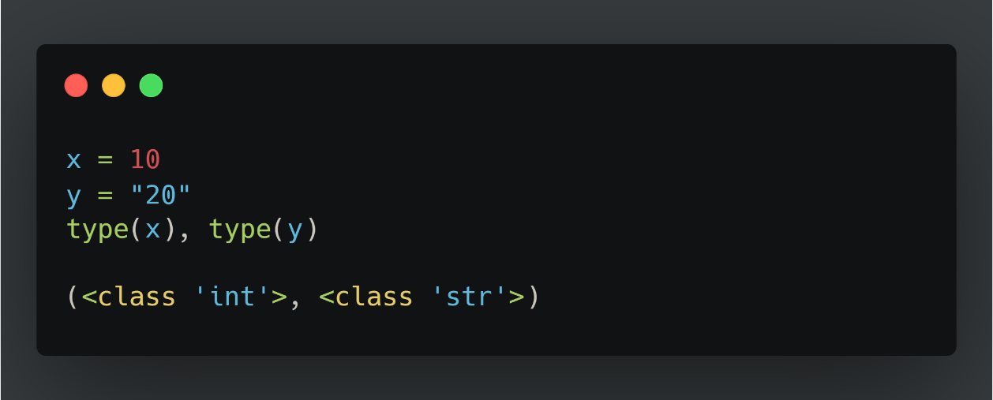
Important lesson to remember!
We can't do arithmetic operations on variables of different types. Therefore make sure that you are always aware of your variables types!
You can find the type of a variable using type(). For example type type(x).

Slide 11
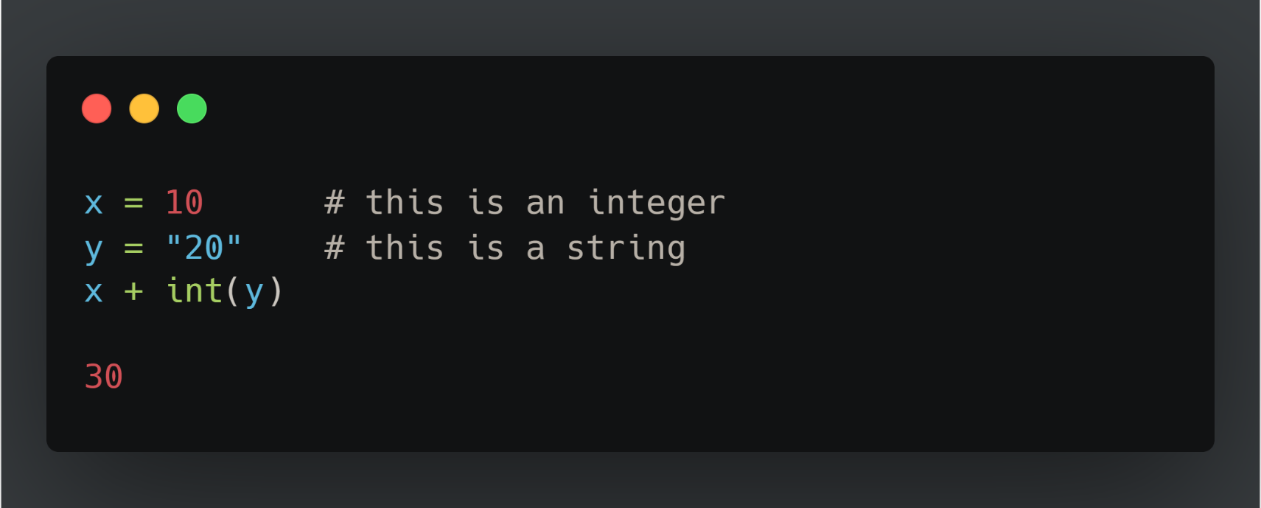
Casting types
Luckily Python offers us a way of converting variables to different types!
Casting – the operation of converting a variable to a different type
Similar methods exist for other data types: int(), float(), str()

Slide 12
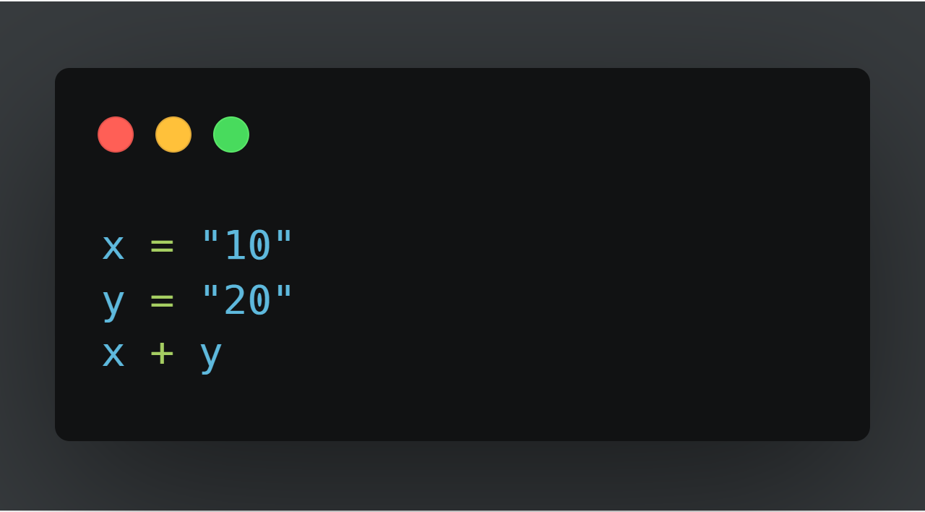
Quick Quiz

Slide 13
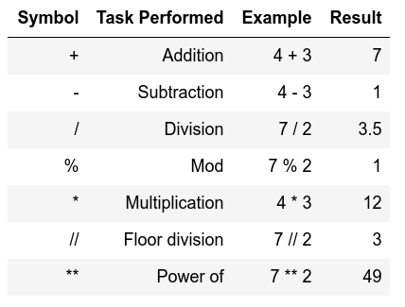
Arithmetic operations
Similar to actual Mathematics.
Order of precedence is the same as in Mathematics.
We can also use parenthesis ()

Slide 14
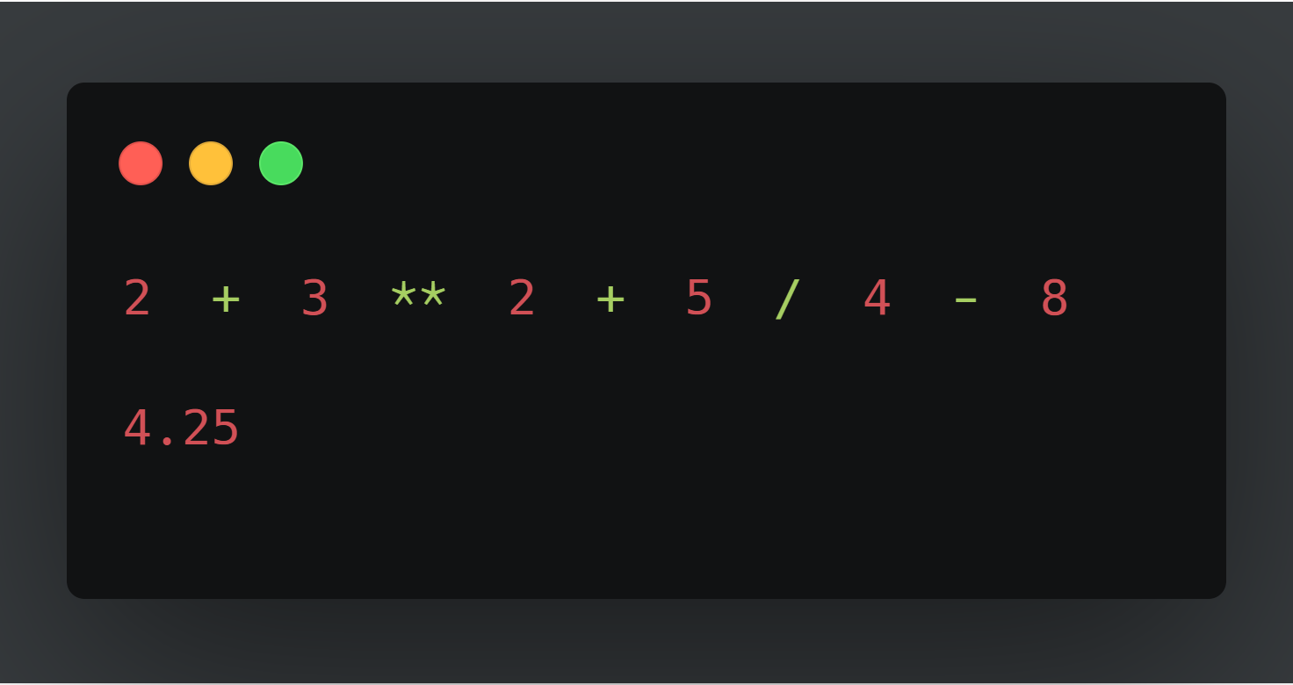
Order precedence example

Slide 15
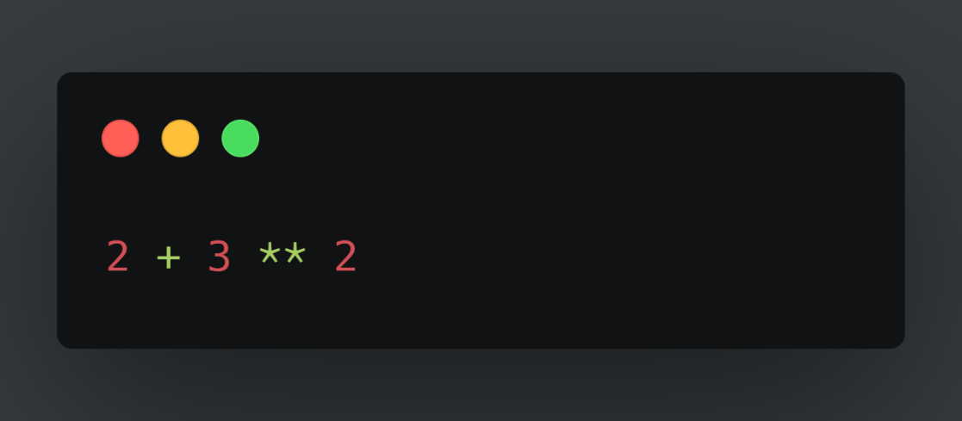

Quick Quiz

Slide 16
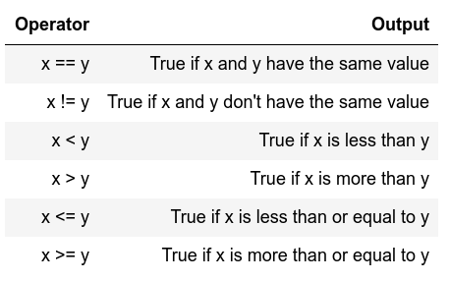
Comparison operators
Return Boolean values
(i.e. True or False)
Used extensively for conditional statements

Slide 17
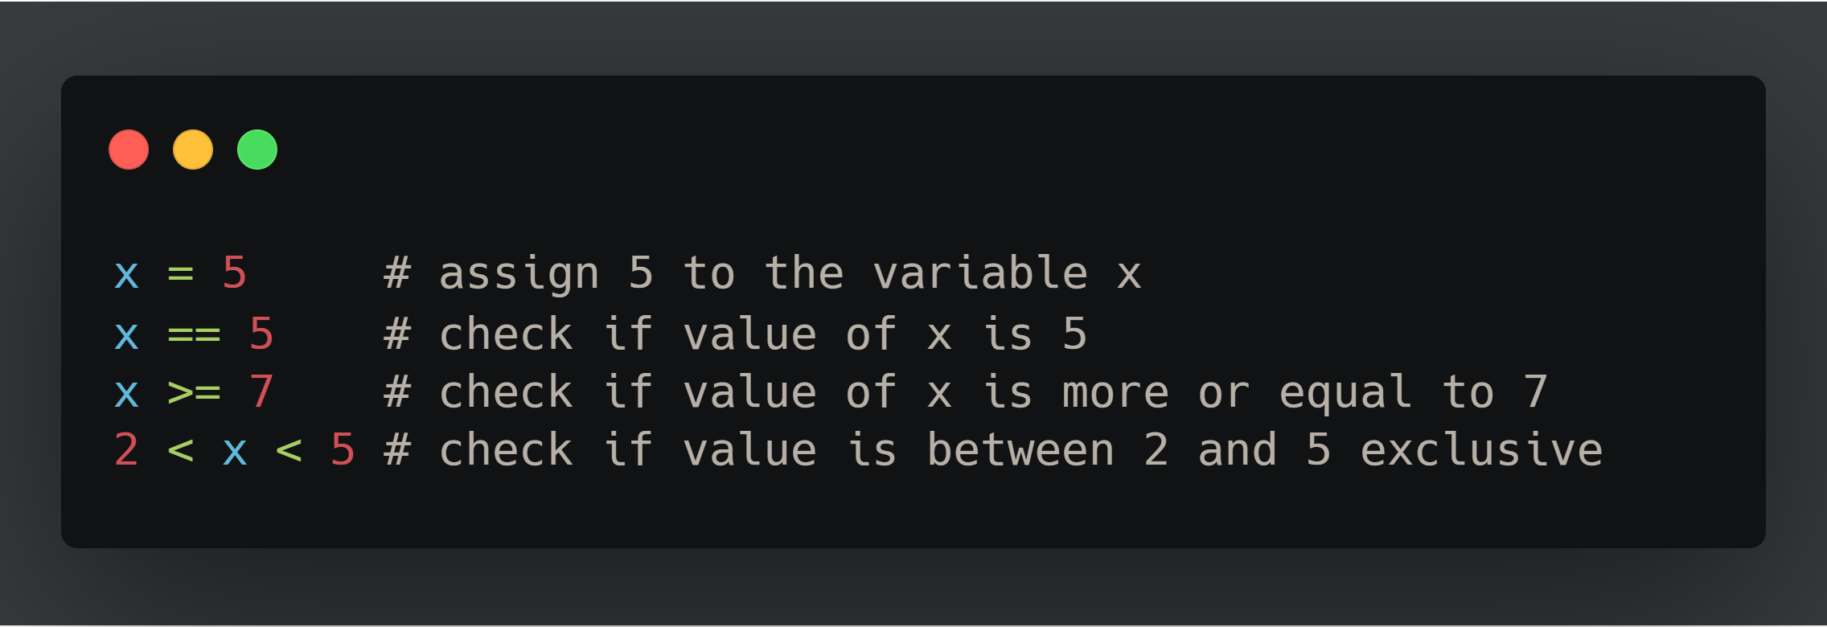
Comparison examples

Slide 18
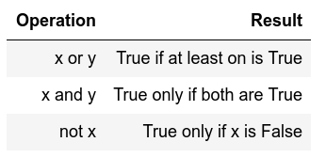
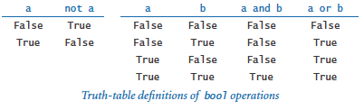
Logical operators
Allows us to extend the conditional logic
Will become essential later on

Slide 19
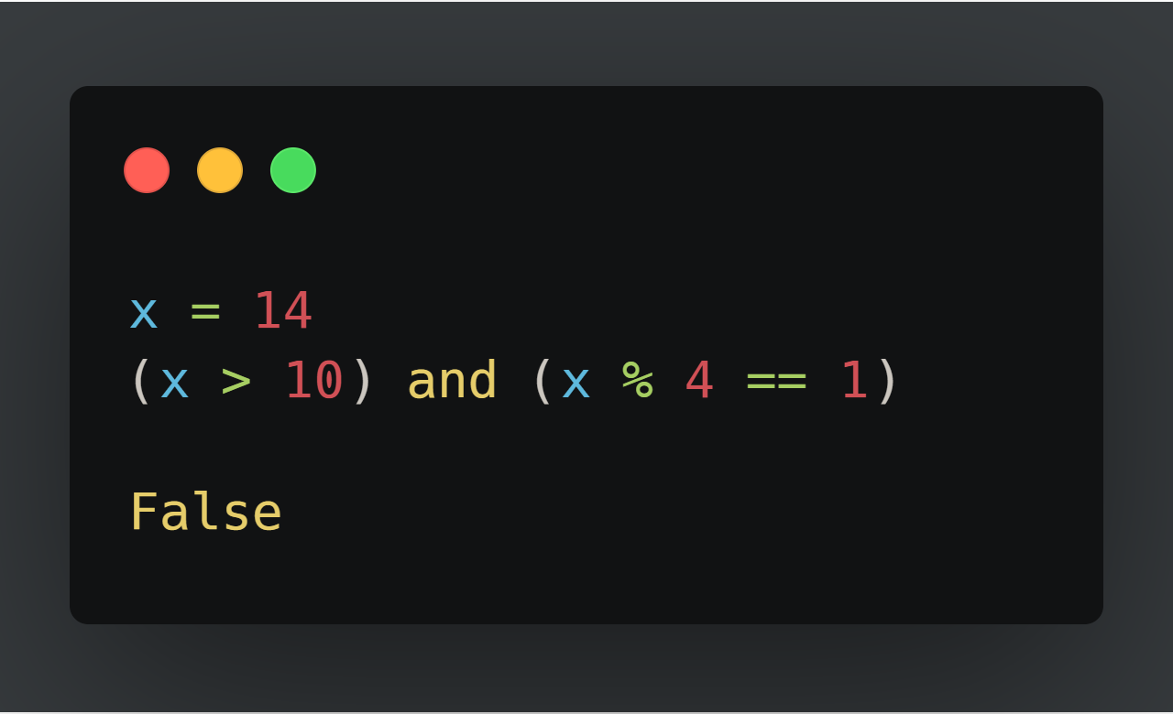
Combining both

Slide 20
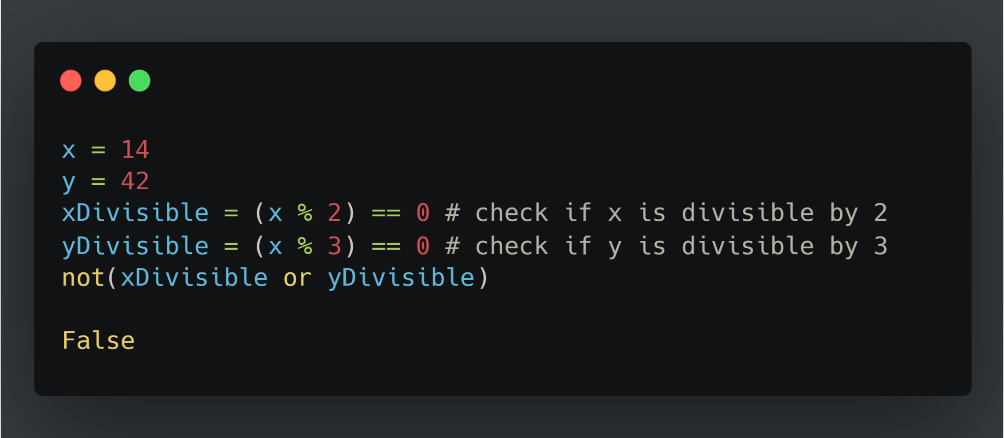
Another Example

Slide 21

Strings
Powerful and flexible in Python
Can be added
Can be multiplied
Can be multiple lines

Slide 22
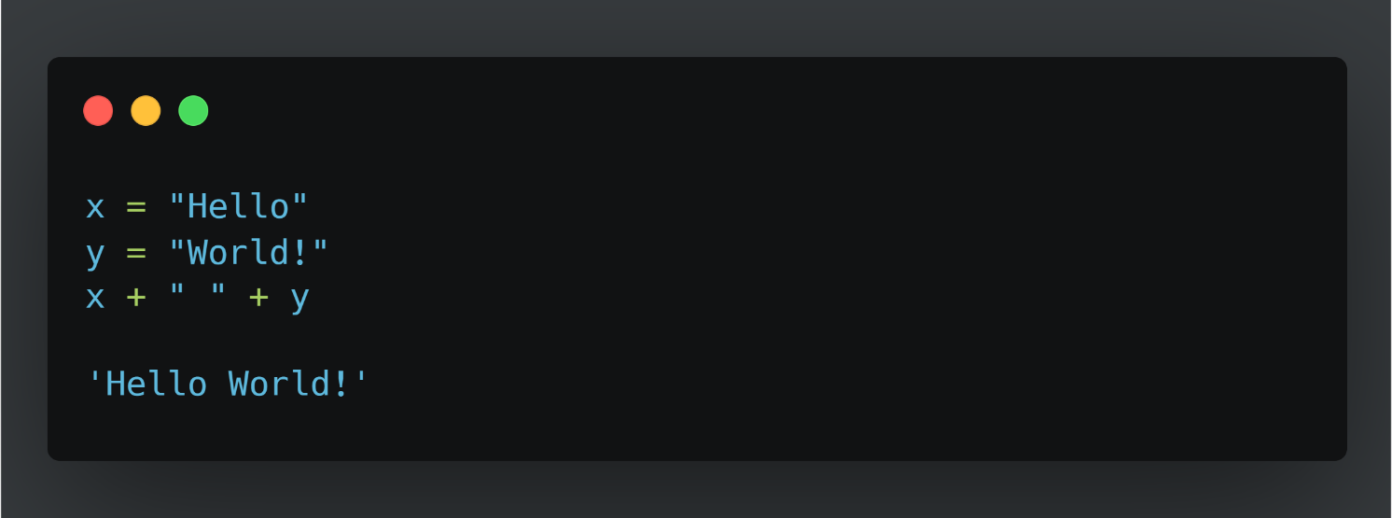
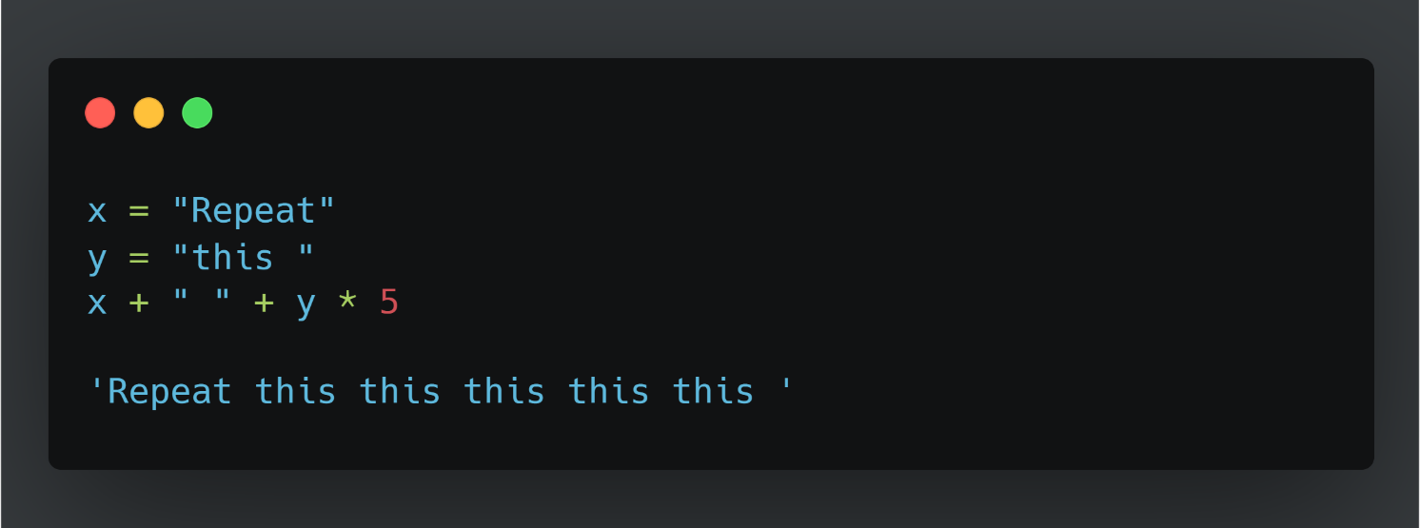
Strings

Slide 23
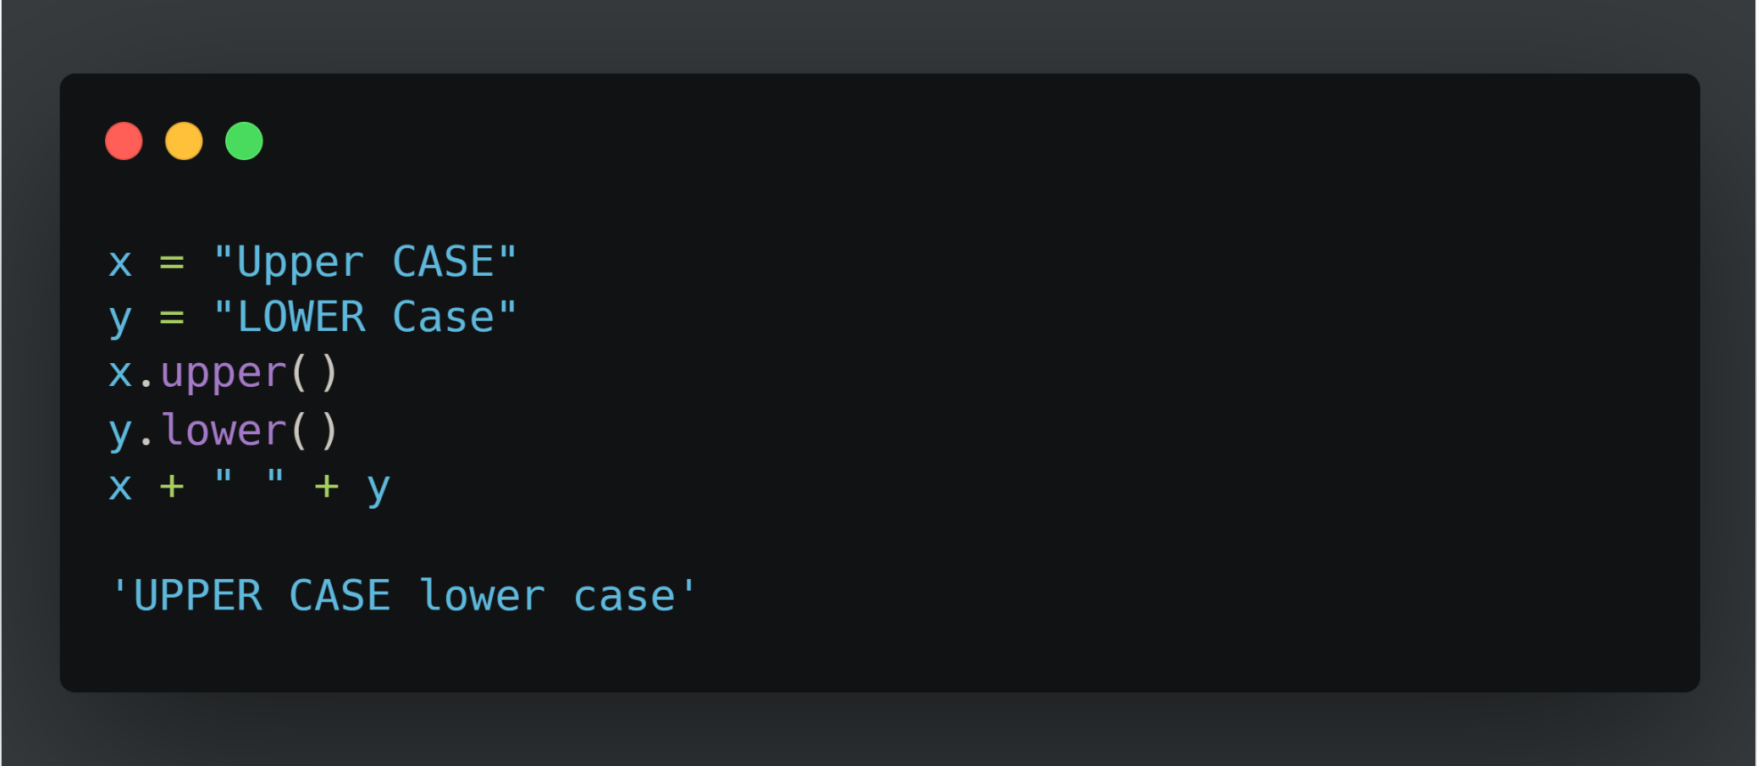
Strings
These are called methods and add extra functionality to the String.
If you want to see more methods that can be applied to a string simply type in dir('str')

Slide 24
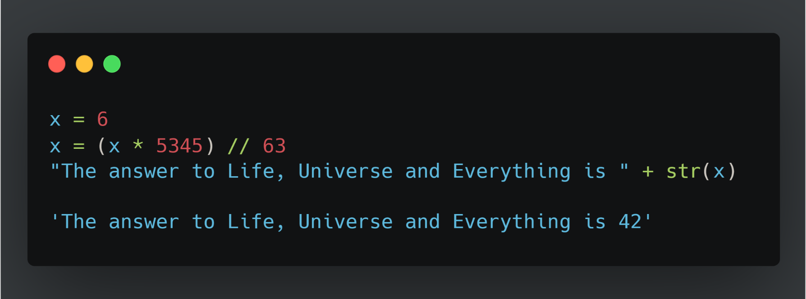
Mixing up strings and numbers
Often we would need to mix up numbers and strings.
It is best to keep numbers as numbers (i.e. int or float)
and cast them to strings whenever we need them as a string.

Slide 25
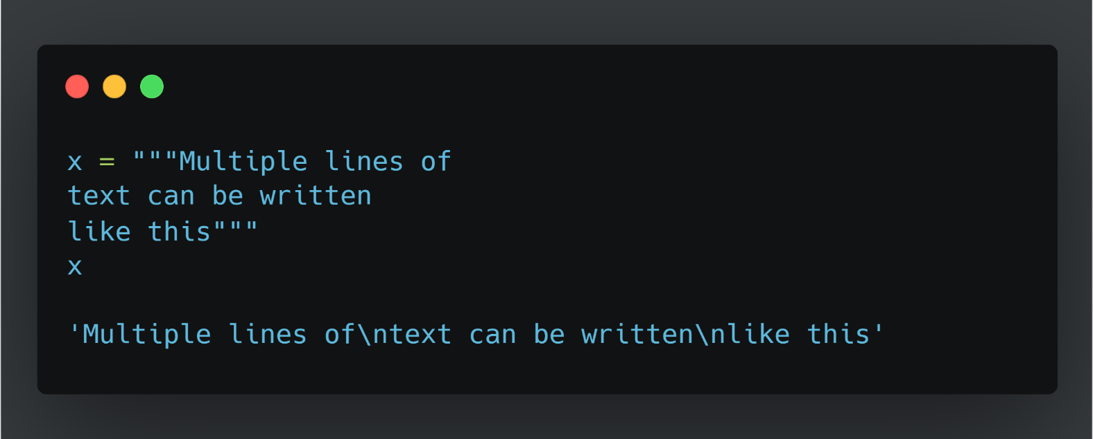
Multiline strings
‘\n’ is escape character for new line
‘\t’ is escape character for tab space

Slide 26
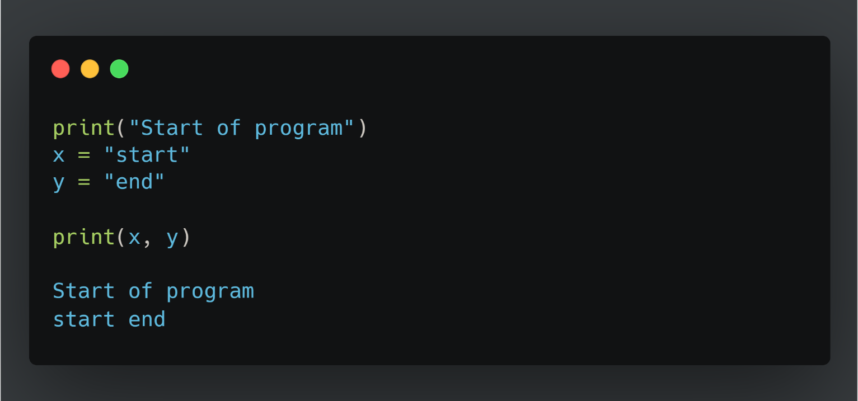
Printing
When writing scripts, your outcomes aren't printed on the terminal.
Thus, you must print them yourself with the print() function.
Beware to not mix up the different type of variables!

Slide 27
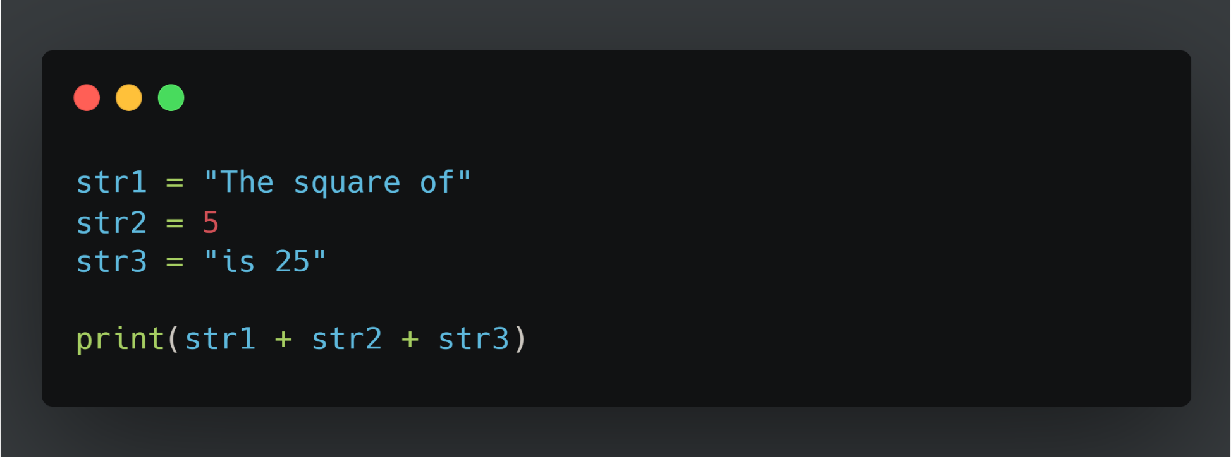
Quick Quiz

Slide 28
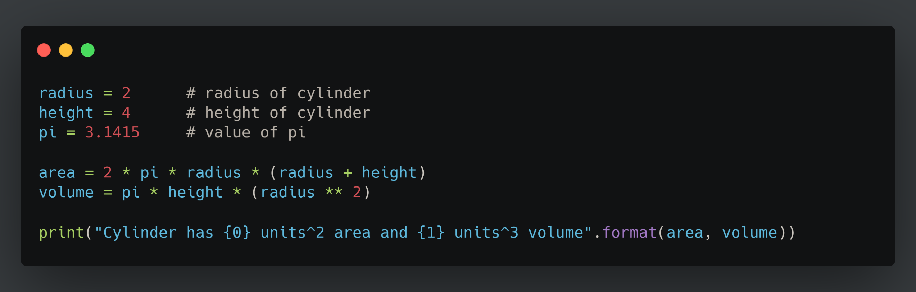
Placeholders

Slide 29
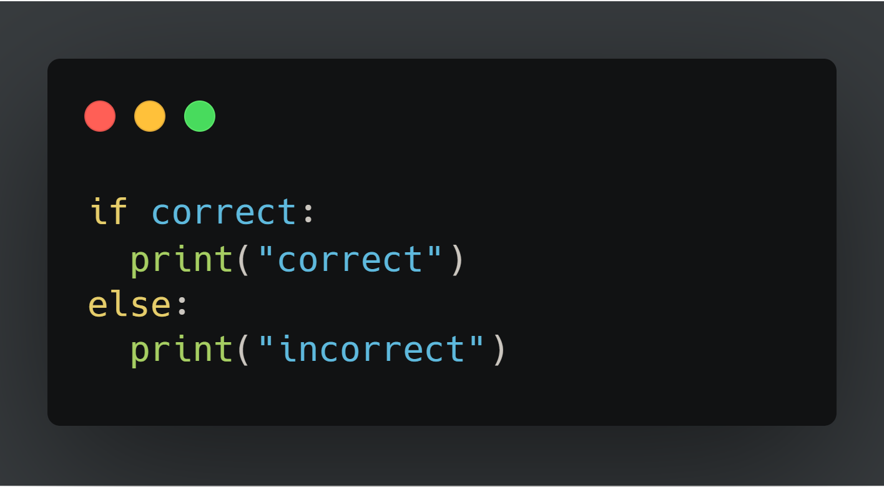
If Else
Fundamental building block of software

Slide 30
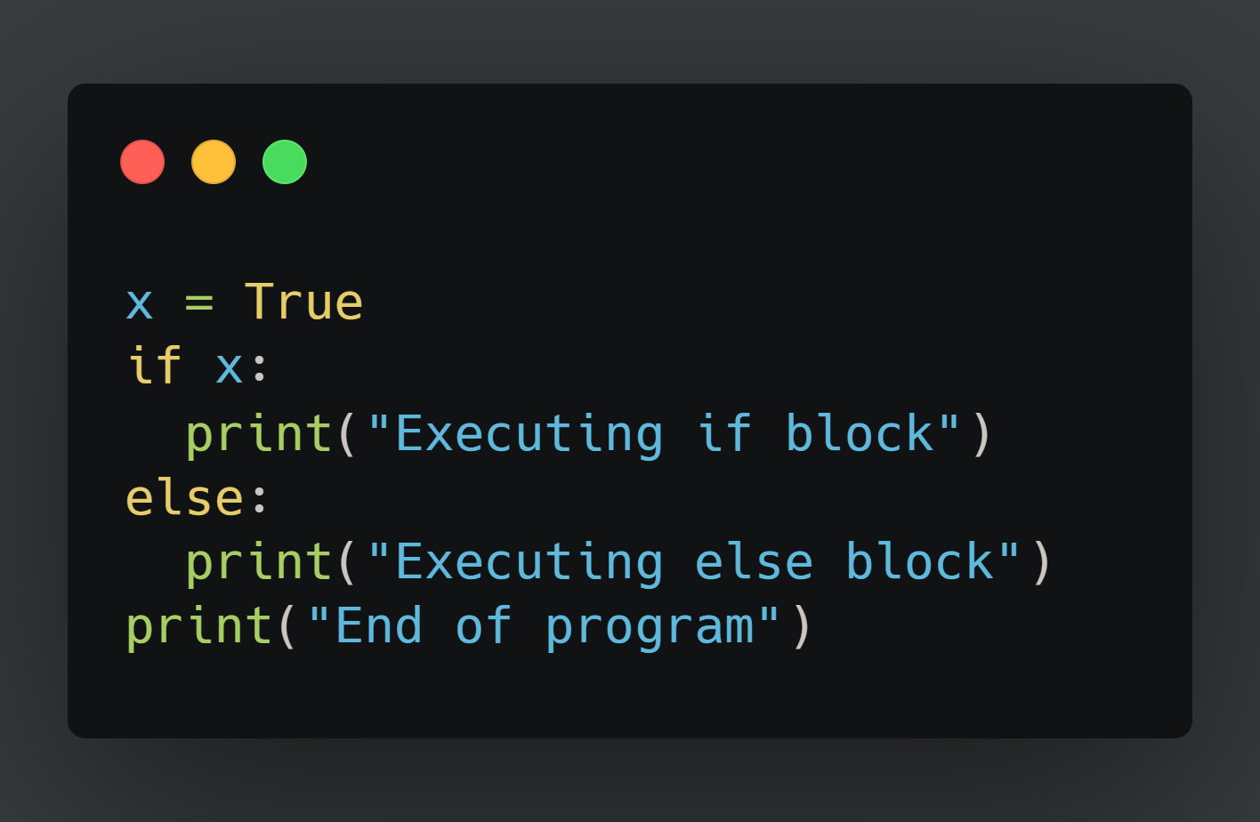
If Else example
Try running the example below.
What do you get?

Slide 31
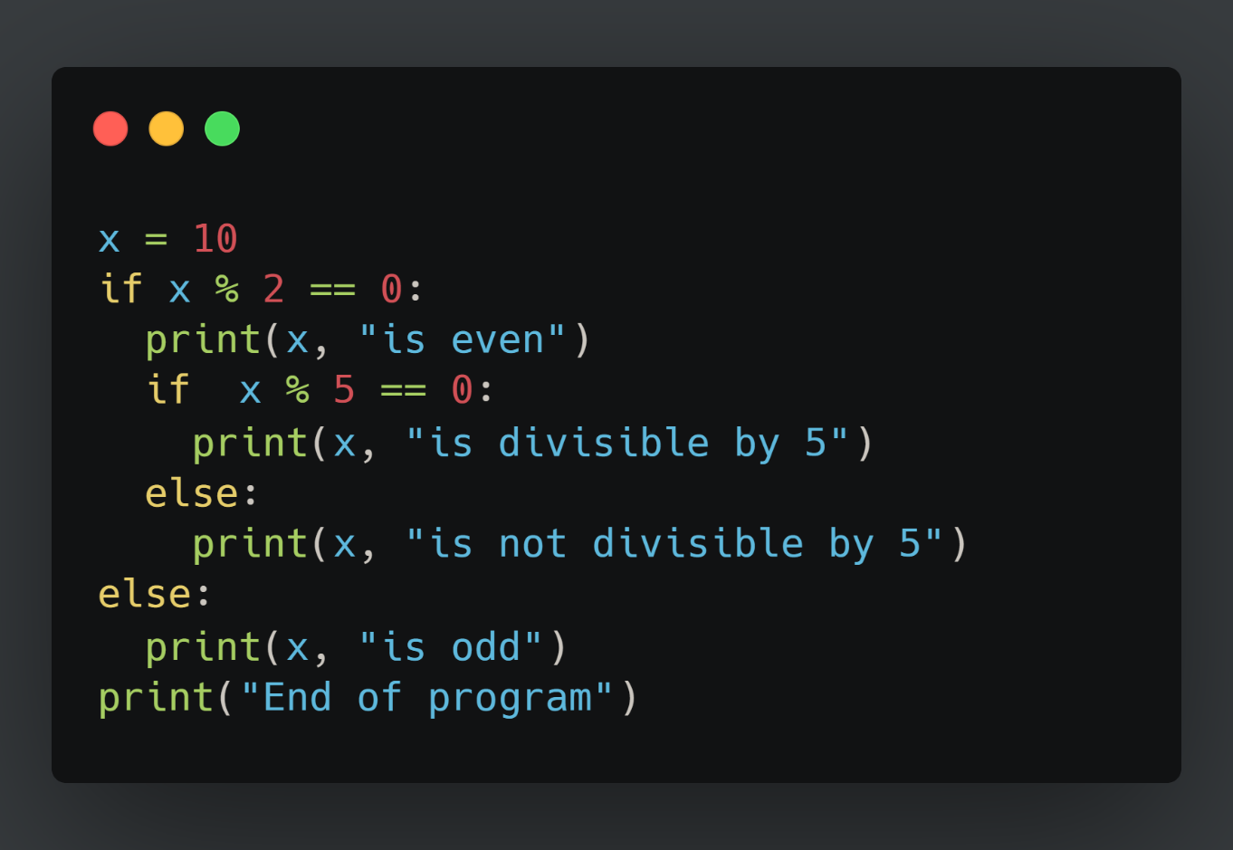
Indentation matters!
Code is grouped by its indentation
Indentation is the number of whitespace or tab characters before the code.
If you put code in the wrong block then you will get unexpected behavior

Slide 32
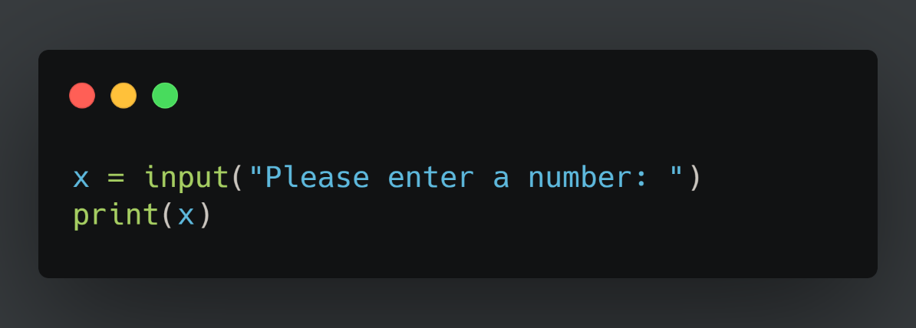
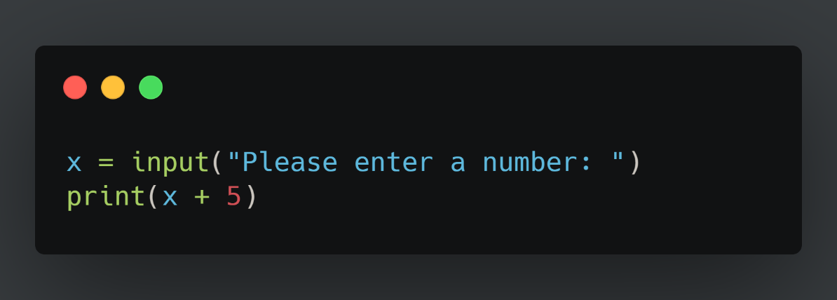
Input
Most of the programs you write will need to take input from the user
For this, you must take input from the user using the input() function.
By default input is in string type

Slide 33
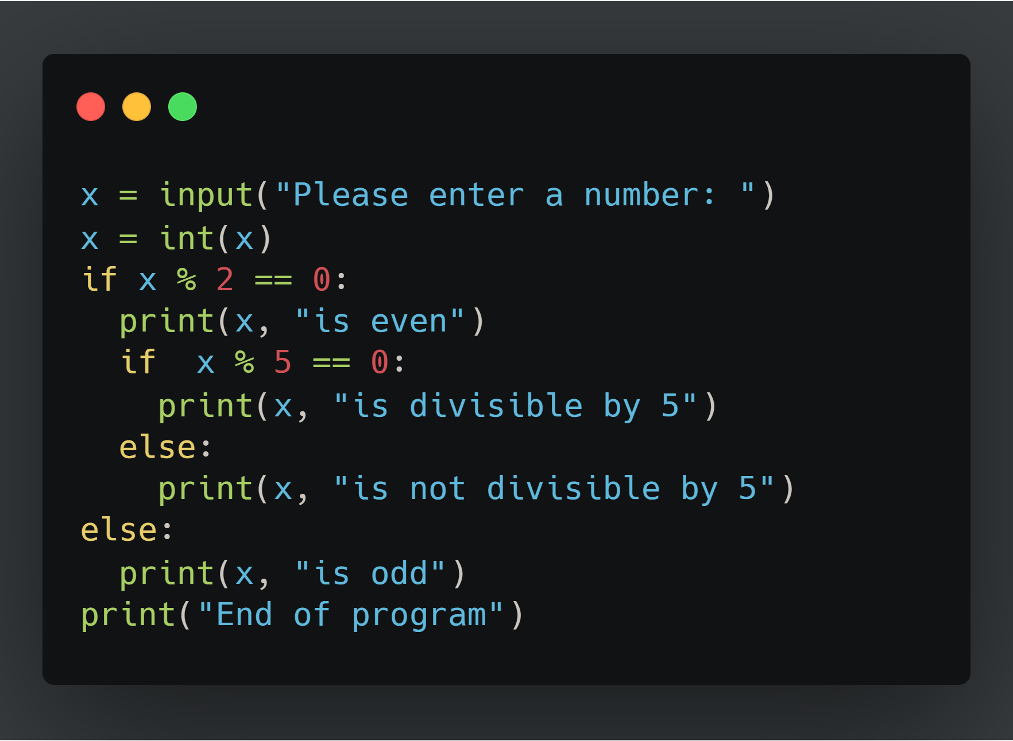

Slide 34
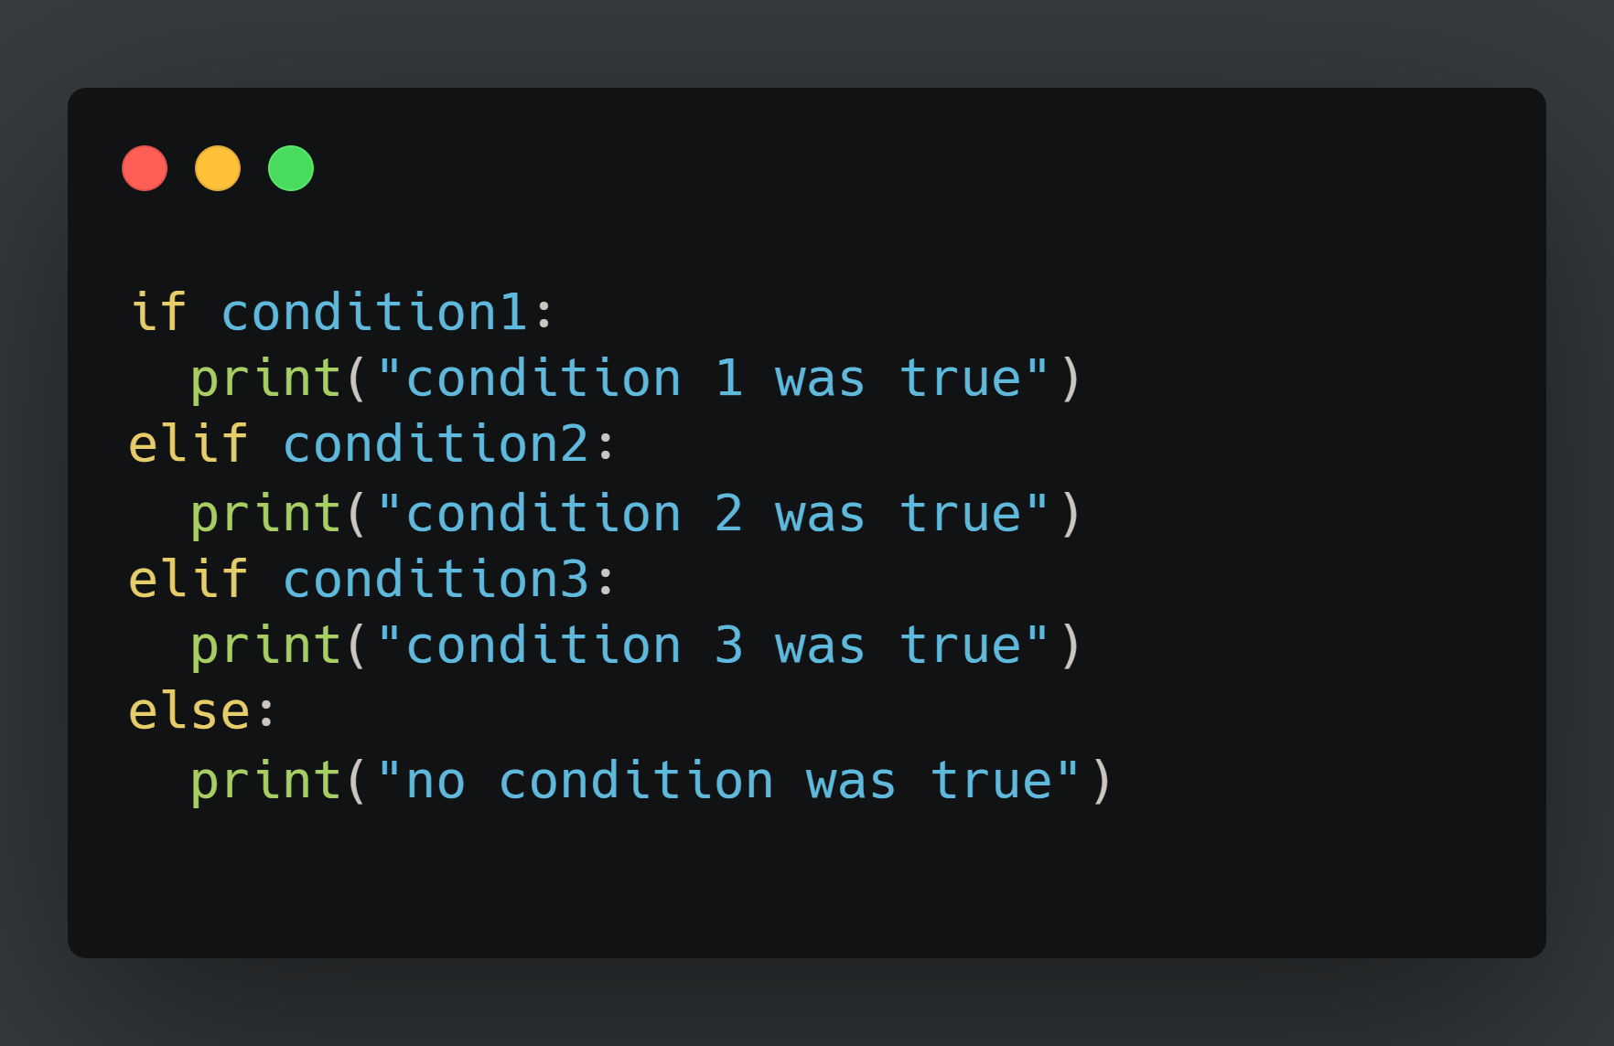
Extending if-else blocks
We can add infinitely more if statements using elif
elif = else + if which means that the previous statements must be false for the current one to evaluate to true

Slide 35
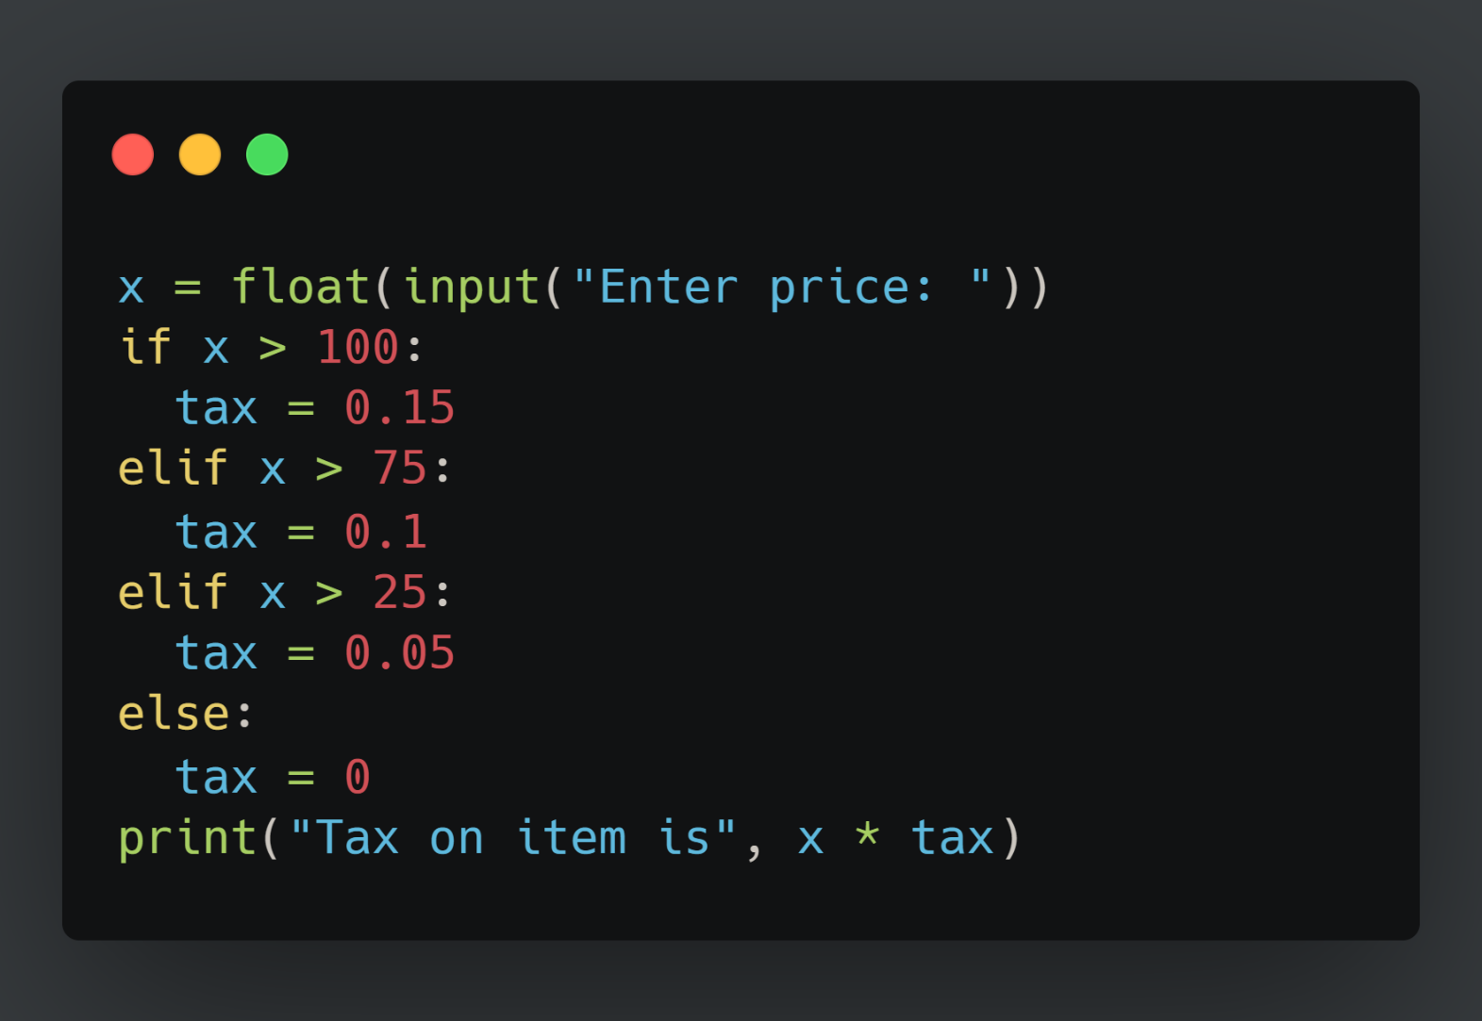
Quick Quiz
What would happen if both conditions are True?

Slide 36
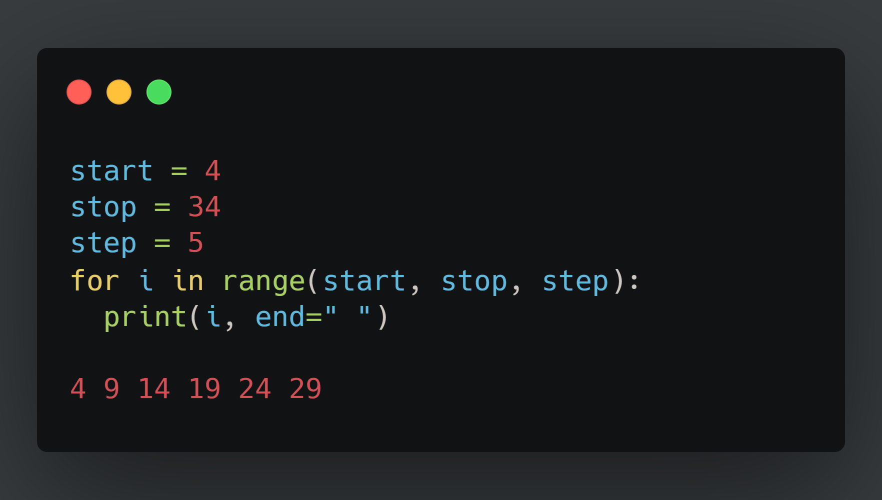
Fixed Loops

Slide 37
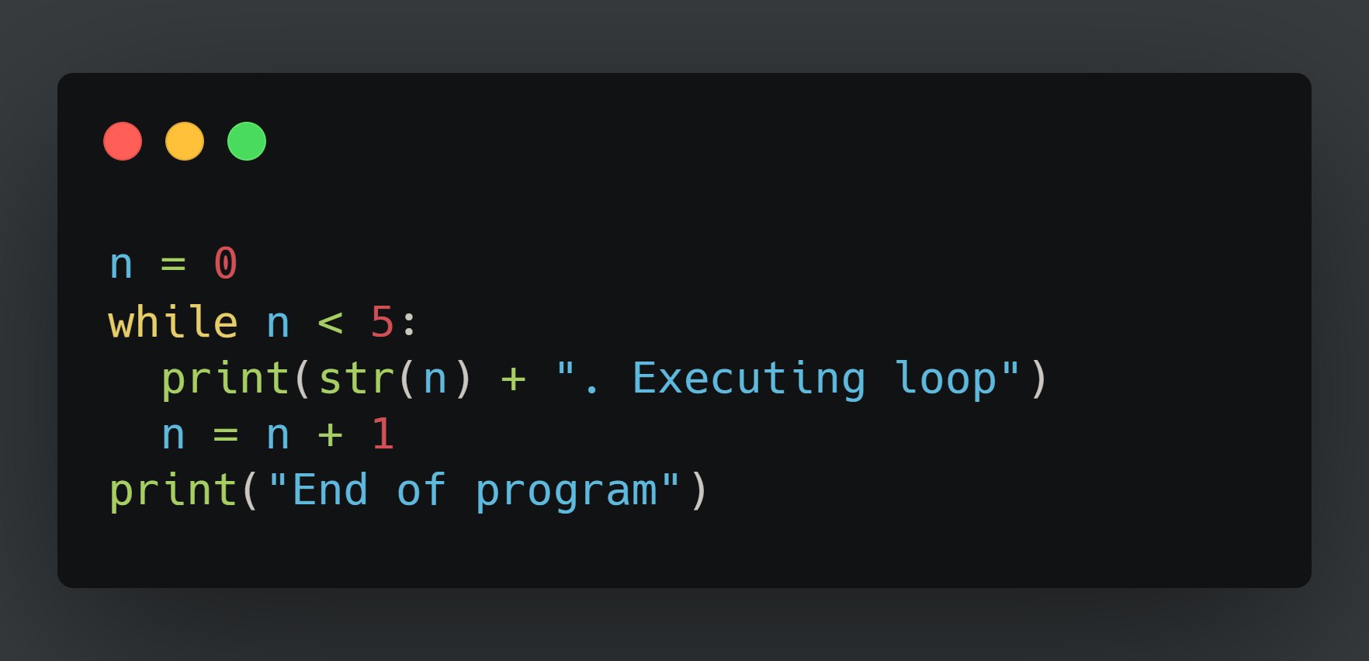
Conditional Loops
Another useful loop. Similar to the for loop.
A while loop doesn't run for a predefined number of iterations, like a for loop. Instead, it stops as soon as a given condition becomes false.

Slide 38
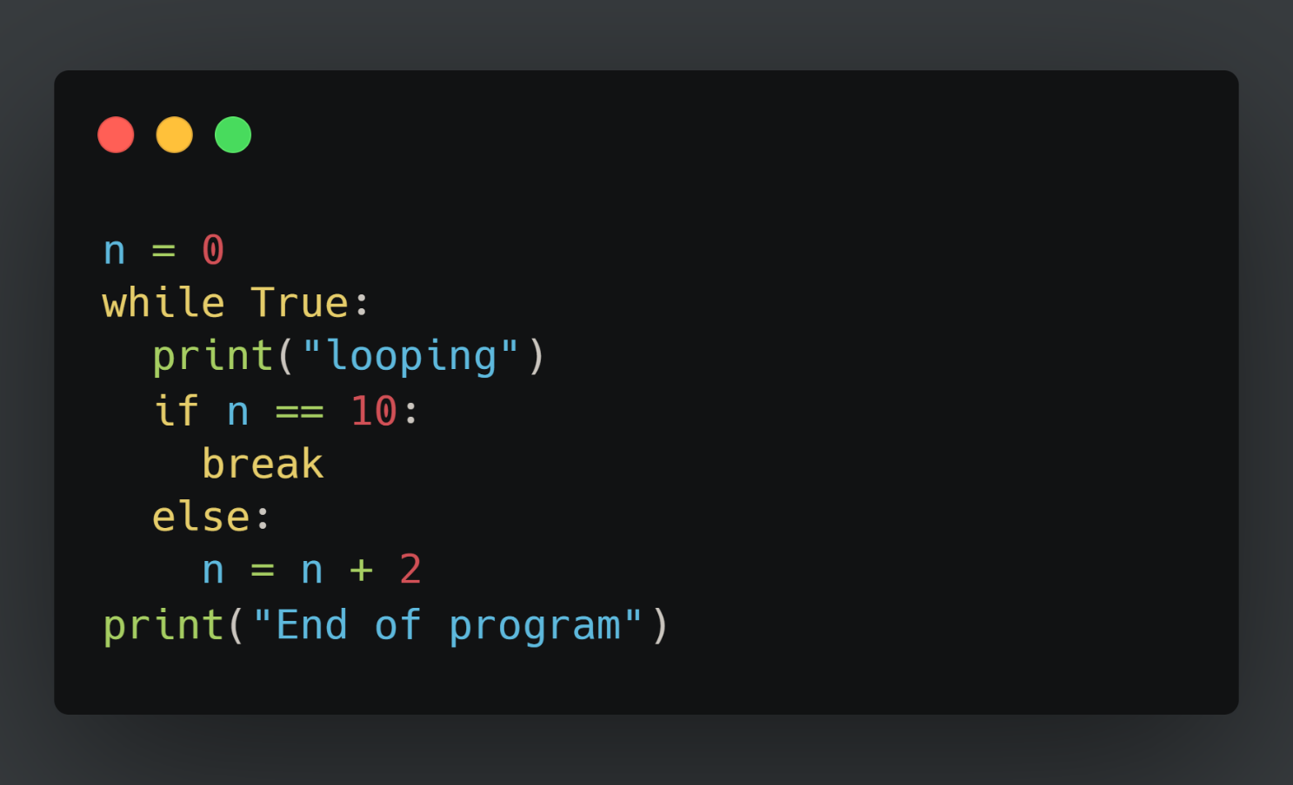
Break statement
Allows us to go(break) out of a loop preliminary.
Adds a bit of controllability to a while loop.
Usually used with an if.
Can also be used in a for loop.

Slide 39
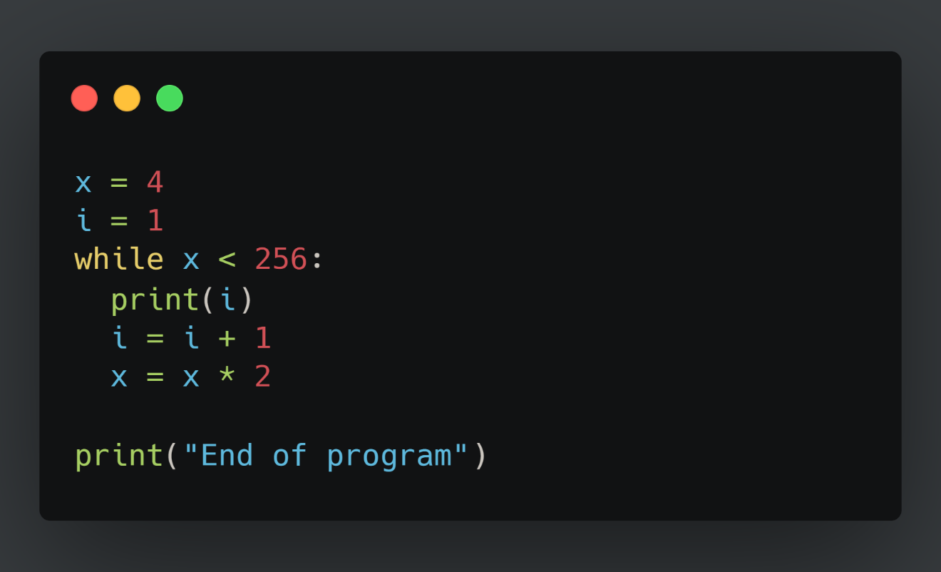
Quick quiz
How many times are we going to execute the while loop?

Slide 40
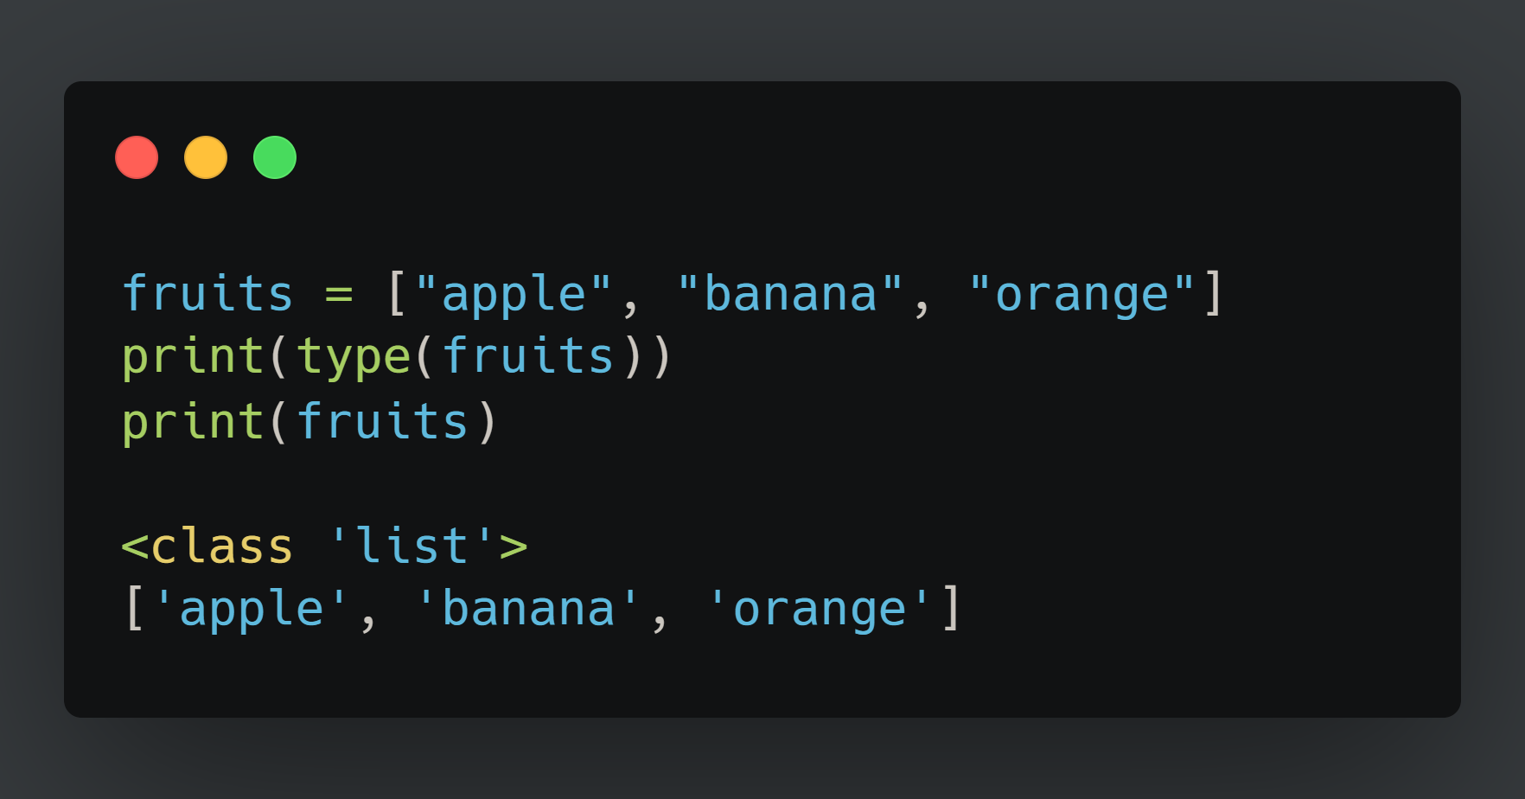
List

Slide 41
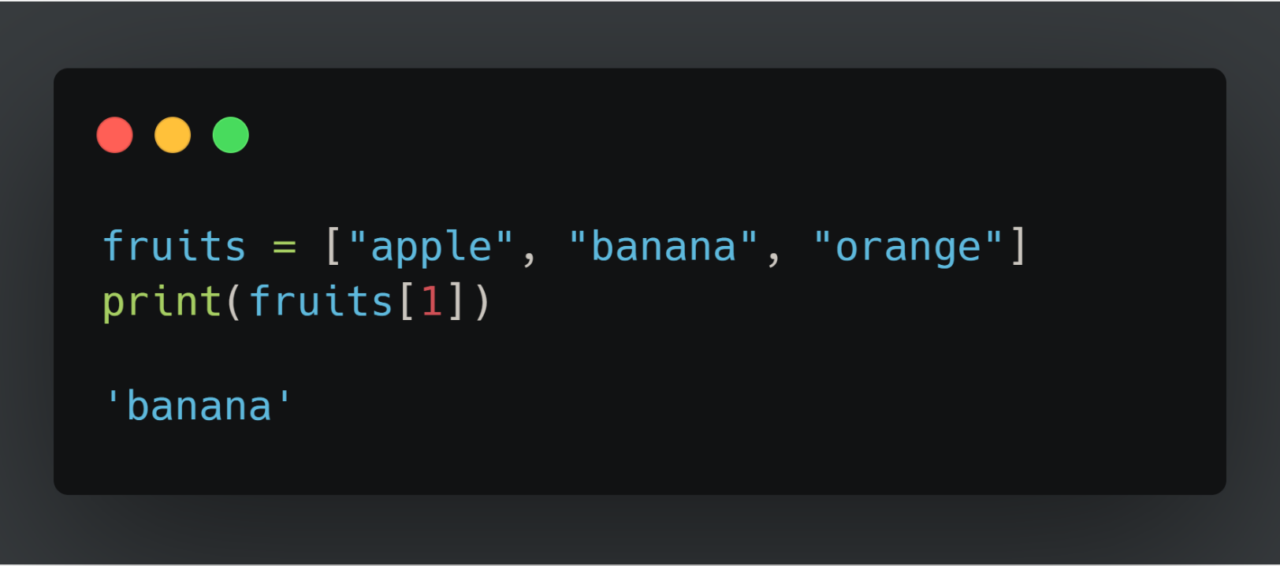
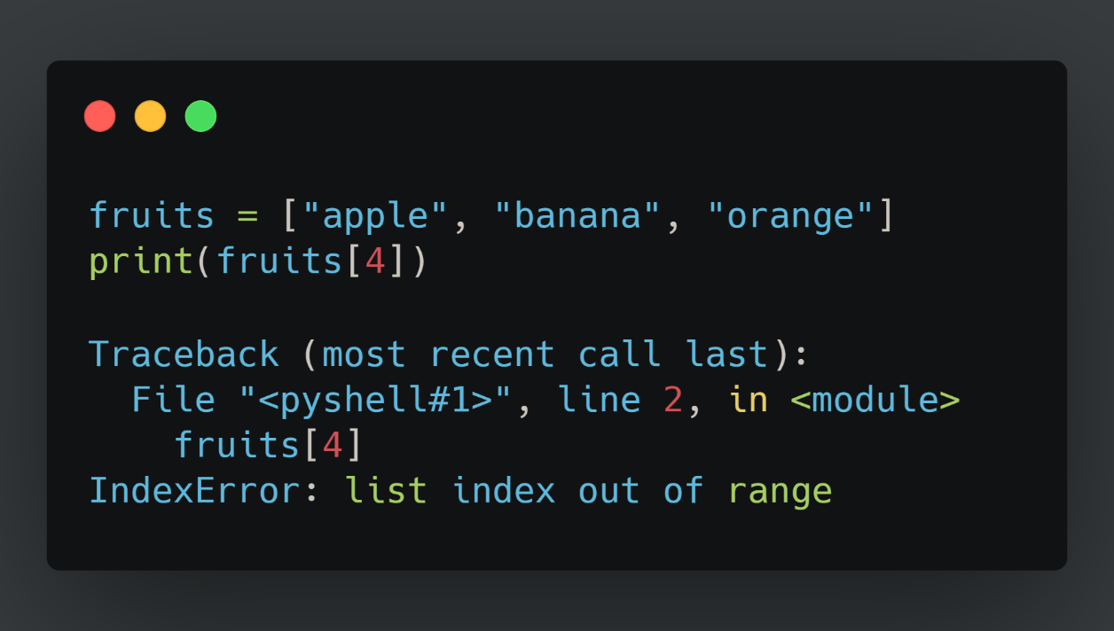
List
We can access each of the individual element in the array using the subscript notation
Index of lists start from 0

Slide 42
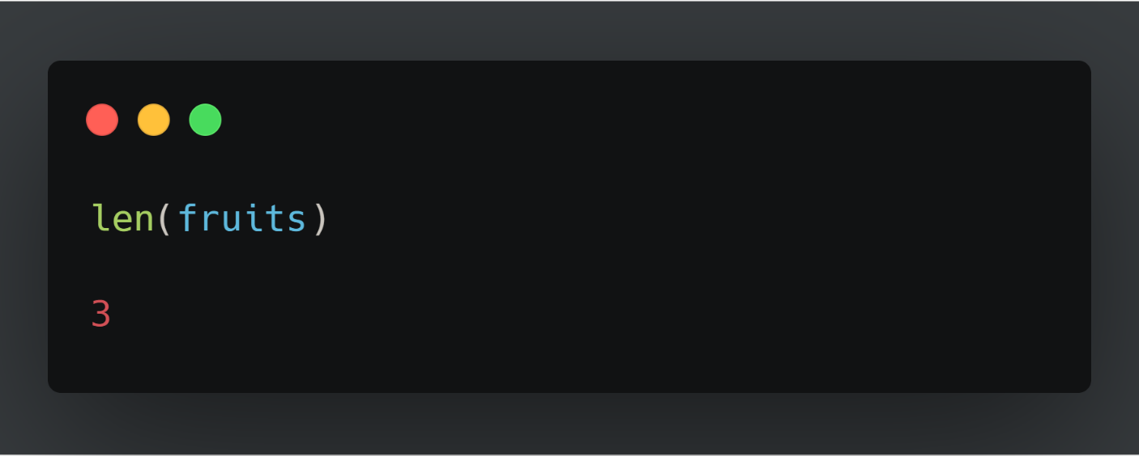
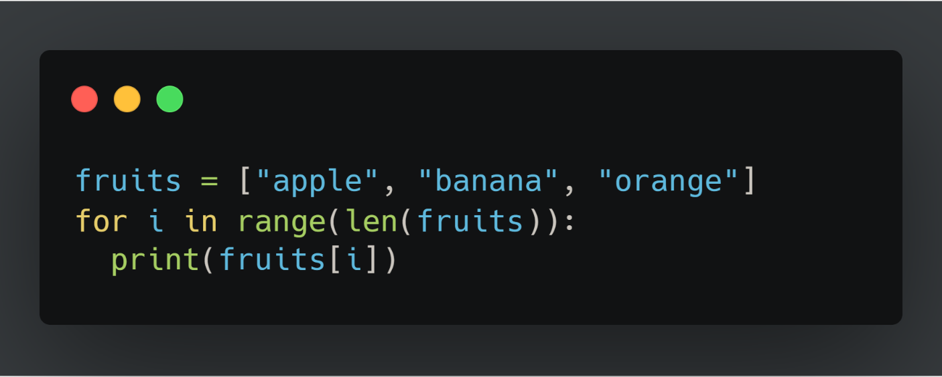
Example
Say we want to go over a list and print each item along with its index
What if we have much more than 4 items in the list, say, 1000?

Slide 43
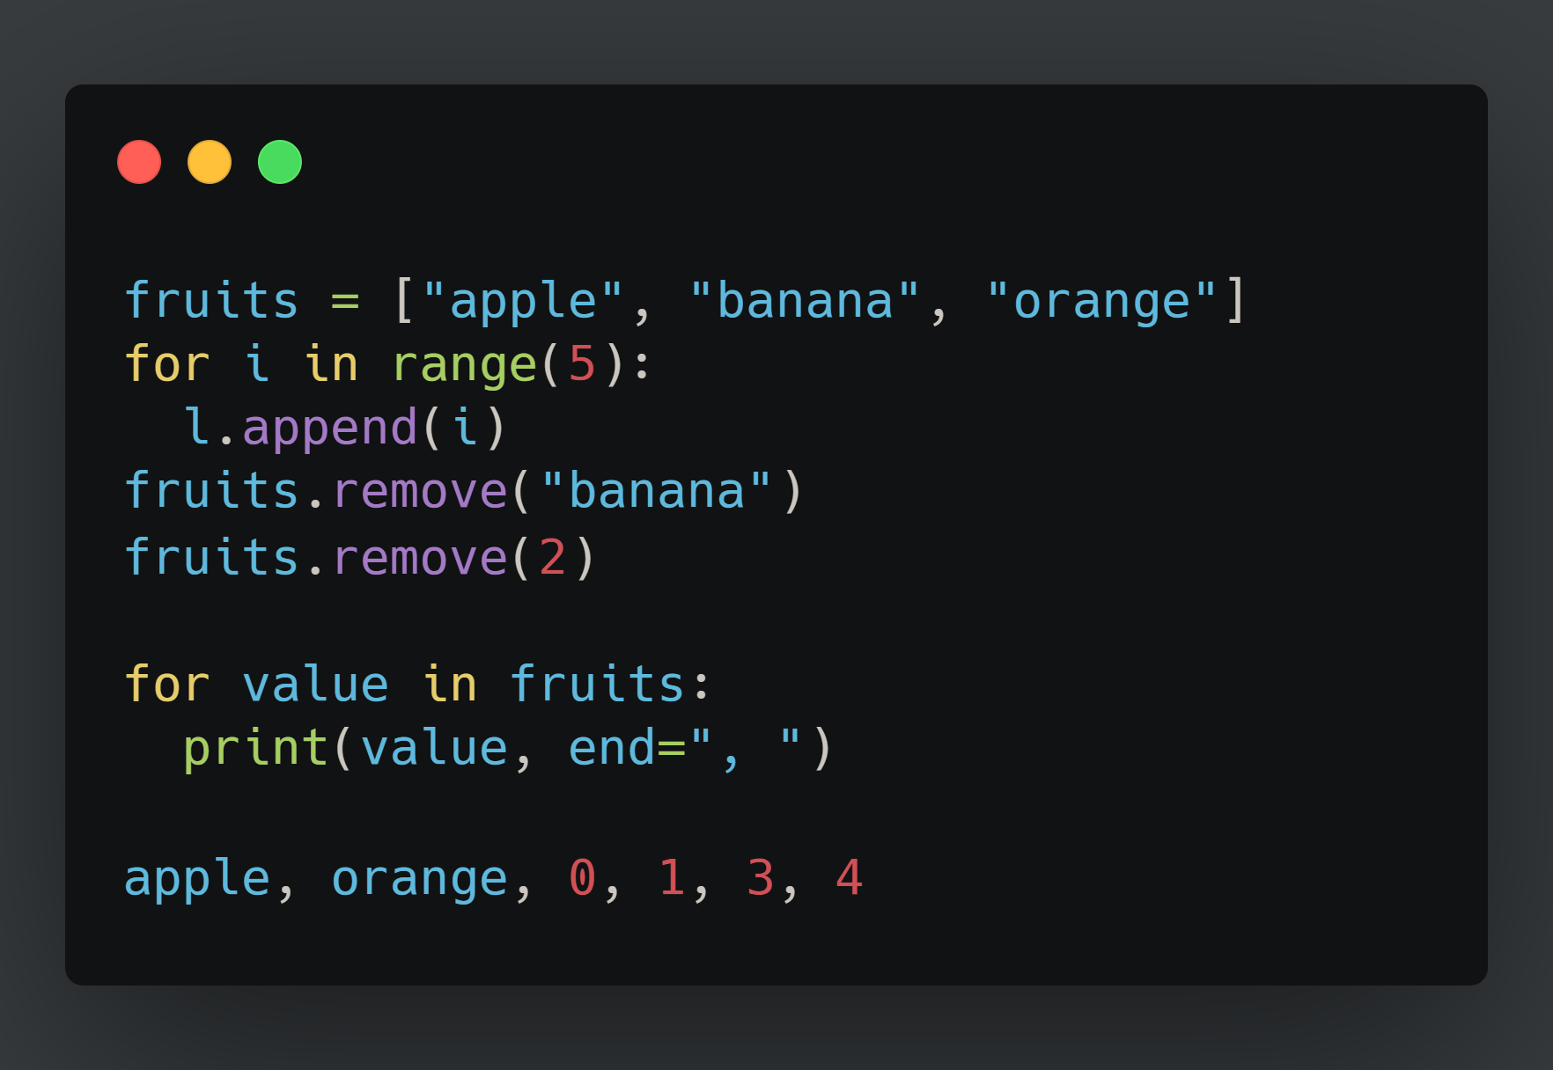
More Examples

Slide 44
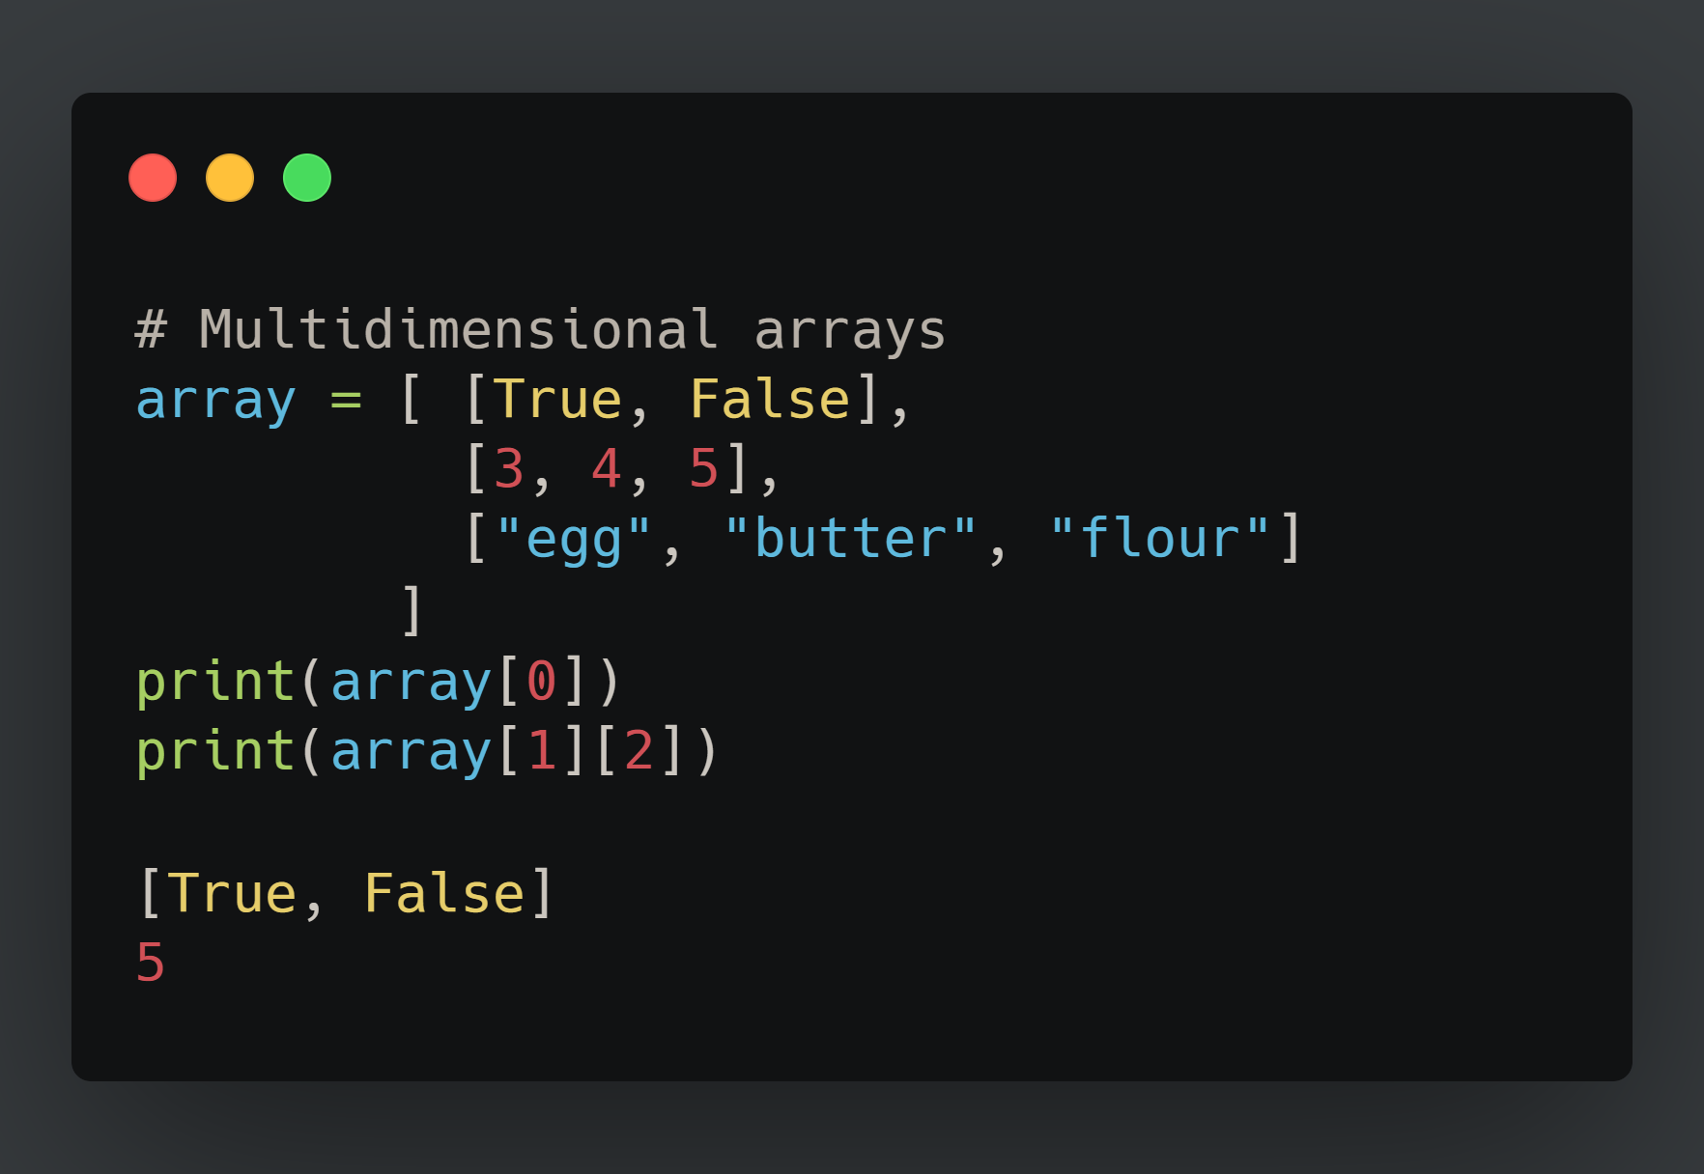
List Multidimensional

Slide 45
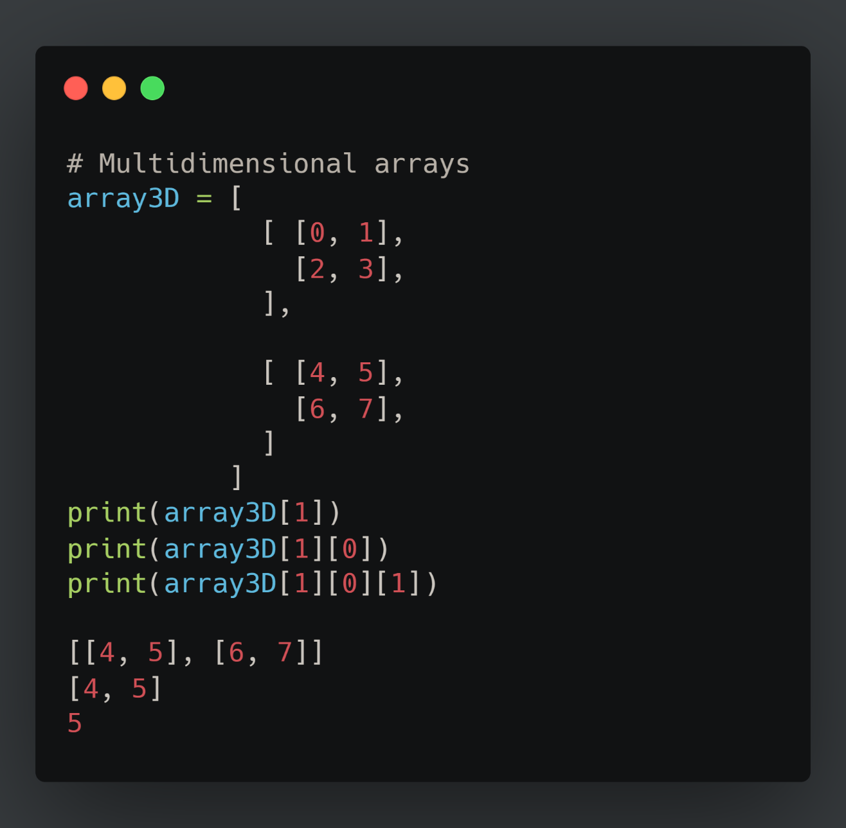
3D arrays

Slide 46
Thank You

